Slide 1
C++ Programming Today 2nd Edition By Barbara Johnston Chapter 4
Instructor: Rob Garner
Lecture Slides by Kelly Montoya and Rob Garner

Slide 2
Overview
Basic Function Characteristics
Types of functions
Calling and Called Functions
How to write functions
Return Statement
Function Calls
Function variables
Troubleshooting Functions
Overloaded Functions
Default Parameter Lists
Variable Scope
Multi-File Programs
String Stream Class
Common Errors With Functions

Slide 3
Basic Function Characteristics
Describe the basic characteristics of functions in C++

Slide 4
Functions in C++
A function is a complete section (block) of C++ code with a definite start point and an end point between curly braces and its own set of variables.
Functions can be passed data values and they can return data.
Functions should be designed so that they have one primary task to accomplish.

Slide 5
Three Important Questions
“What is the function supposed to do? (Who’s job is it?” )
If a function is to read all data from a file, that function should open the file, read the data, and close the file.
“What input values does the function need to do its job?”
If your function is supposed to calculate the volume of a pond, you’d need to give it the pond dimensions.
“What will my function return to me?”
What will the function give you when it has finished its task?

Slide 6
Functions: Basic Format
return_type function_name(input parameter list)
{
// Body of function
}
The return_type is the data type of the value returned from the function.
The function_name is the identifier (name) of the function and is used to access the function.
The input parameter list is the list of the input variable data types and names that the function receives.

Slide 7
How many tasks should you design a function to accomplish?
One and only one task.
As many as you need.

Slide 8
Types of functions
Identify different types of functions

Slide 9
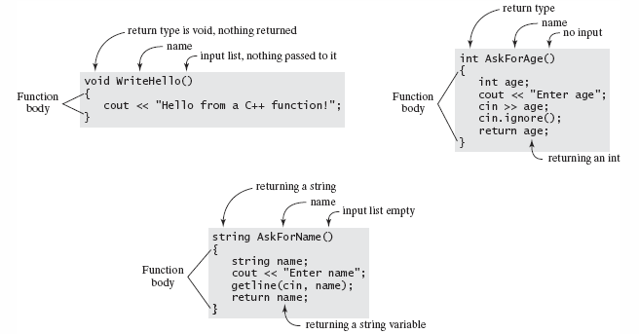
Three examples of simple functions
Notes:
Programs 4-1 and 4-2 illustrate simple functions.

Slide 10
All functions in C++ follow this basic format.
The function name must follow standard C++ naming conventions.
There may be one return type.
If there is no return type, the void data type is used.
The input argument list must have data type and names (separated by commas)
You may pass in as many arguments as you like.
If your list is empty (no arguments are passed), the parentheses will be empty () but still required

Slide 11
Void Parameterless Function
The following function, named WriteHello() is passed nothing and returns nothing.
Nothing returned.
No parameters.
void WriteHello()
{
cout << "\n Hello from a function!";
}

Slide 12
Parameterless Function that returns a value
int AskForAge()
{
int age;
cout << "\n How old are you? ";
cin >> age;
cin.ignore(); //remove enter key
return age;
}
No parameters.
cin statement leaves the Enter key in the input queue. cin.ignore() function removed that Enter key.
Return key word will return value in age.

Slide 13
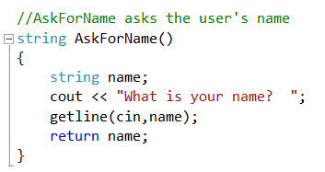
Parameterless function that returns a value
Zero parameters.
Data is read into a string object using getline()
Return key word will return value in name.

Slide 14
Functions with parameters that returns void
The input parameter list has two data items :name and age
It doesn’t “return” anything
void Write(string name, int age)
{
cout << "\n Hi " << name << "! You are "
<< age << " years old. \n";
}
The Write function’s job is to write the user’s name and age to the screen
Notes:
Program 4-2

Slide 15
How many return types can a function have?
None
One
More than one
None or one

Slide 16
If a function returns nothing what do we use for the return type?
Leave it blank.
Use the keyword: void

Slide 17
Calling and Called Functions
Explain the distinction between calling and called functions.

Slide 18
Calling and Called Functions
The terms calling function and called function are often used when referring to functions.
When one function (Function1) accesses another function (Function2), it is said that Function1 calls Function2.
That is, Function1 is the calling function and Function2 is the called function.

Slide 19
Calling and Called Functions
In order to invoke (make use of) the function, you’ll need to have a statement that calls it.
The calling statement is the code located in the program where the function is to be used or accessed.
Depending on the requirements for the function (input list) and return type—your function calls may vary in appearance.
In the example, main() calls all other functions.

Slide 20
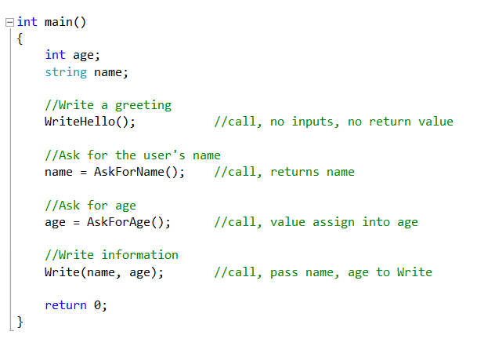
Calling and Called Functions
Calling function is main.
Called function is AskForName
String return type so assigned into name.
Void so no assignment operator.

Slide 21
How to write functions
Explain how to write functions.

Slide 22
Every function must have:
Function prototype/declaration statement which tells the compiler the function name, and its return and input types.
Function definition/body which contains the actual code that performs the function’s task.
The first line of the function definition is the function header line.
That line contains the return type, function name, and input parameter list.

Slide 23
Concentrate on the Function First
Concentrate on one function at a time.
Work as if you can’t see other parts of the program.
Each function is its own block of code, with its own variables and control statements.
Write the prototype, see if it can be called, then write the function.

Slide 24
The C++ Hotel Example
There are three different rooms based on the view.
The view of the beach costs $99.95
The view of the pool costs $79.95
The view of the parking lot costs $59.95
These rates are for a single room with one person.
Each additional person is $10 per night.
Notes:
Program 4-3, the C++ Hotel

Slide 25
See how functions must be laid out in the source code file.
Notes:
Program 4-3

Slide 26
Function Declaration or Prototype
Before a function can be called, the calling function must know about the called function.
The prototype may be declared in the calling function before the call, it can appear above the calling function or it can appear in an include file.
The important point is that the compiler must have seen the function prototype before the function is called.

Slide 27
Function Declaration or Prototype
The form of the function prototype is:
These statements must be seen before they are called. Here they are in the source code above the main() function.
Return_type function_name(type param, …);

Slide 28
Six prototypes in the C++ Hotel program
No inputs no return value:
No inputs and return integers or a string object.
Three input values, 2 ints, 1 string, returns a float.
Four input values, no return value.
void WriteGreeting();
int HowManyPeople();
int HowManyNights();
string WhatTypeRoom();
float CalcCost(int people, int nights, string roomType);
void WriteCostSummary(int people, int nights,
string roomType, float cost);

Slide 29
A function must have a function prototype declared before it can be called.
True
False

Slide 30
If a function is defined before the code that calls it, a separate function prototype is not needed.
True
False

Slide 31
RETURN STATEMENT
Describe the purpose and format of the return statement.

Slide 32
Return Statement
The return statement serves three purposes in a C++ function.
It is required when the function is returning a value to the calling function.
The return statement causes the program control to exit the function and to return to the calling function.
An expression may be evaluated within the parentheses format of the return statement.

Slide 33
Return Statement
The return statement is way to terminate the function and return to the calling function at any point in the function body.
The return statement can be used to return a value or to exit the function if nothing is returned.
The return statement in CalcCost() is:
It could be written like this:
return totalCost;
return ((rate + addPersonCost)* nights);

Slide 34
Return Statement
The function WriteGreeting() does not return a value to the calling function, so no return statement is required:
void WriteGreeting()
{
cout << "\n Welcome to the C++"
<< " Hotel Rate Program"
<< "\n we offer a fine hotel on the beach. \n";
}

Slide 35
The purpose of the return statement is to:
Return a value the calling function.
Causes the program control to exit the function and to return to the calling function.
Provides capability to evaluate an expression and return the result to the calling function.
All of the above.

Slide 36
Functions Demo
Demonstrate how to write functions.

Slide 37
Overview
Basic Function Characteristics
Types of functions
Calling and Called Functions
How to write functions
Return Statement
Function Calls
Function variables
Troubleshooting Functions
Overloaded Functions
Default Parameter Lists
Variable Scope
Multi-File Programs
String Stream Class
Common Errors With Functions

